Slide 1
AMERICAN INTERNATIONAL UNIVERSITY – BANGLADESH (AIUB)
Course: Introduction to Animation
PRODUCTION BIBLE
By
Name: JEBA FAWJIA
ID: 19-39815-1
Submitted to RANI ELLEN V. RAMOS

Slide 2
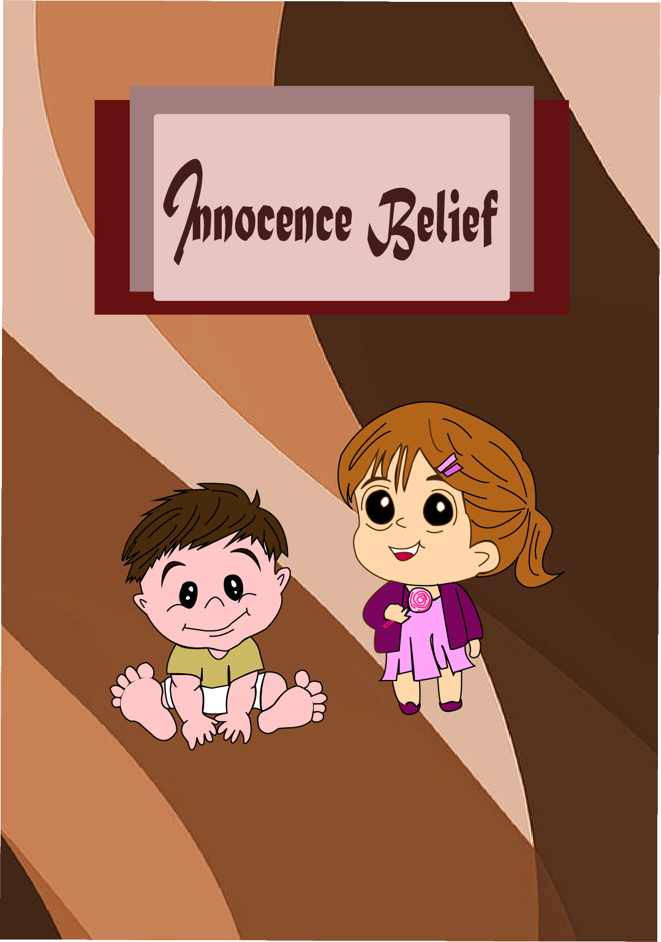
Thumbnail

Slide 3
Series Concept
Innocence Belief
The story begins by showing a 2 years old little boy who sees his face in the mirror and he is quite disturbed for seeing his mouth. Because something is in his mouth which doesn’t understandable for his childish brain. Suddenly, his mother entered the room and saw her son that he is looking in the mirror. Then his mother asked what happened to him. Then he tried to show her mouth and spoke in a stammering language that something is in his mouth. His mother saw and laughed out and said your tooth come out, you have a new tooth! like my see! His mother assures him there is no worry about that. at that time, he remembers his sister who is sleeping in the bed. He doesn’t miss sharing and showing anything with her. He ran on the bed and tried to wake up his sister to show his tooth. When her sister woke up, he starts smiling with his small tooth. he Starts showing his tooth. Her sister saw the tooth and said you have got also new tooth but I lost one tooth 1 month ago. she is a 6-year-old baby. Then she starts thinking of her tooth which she placed in a mouse hole for a new tooth because she heard it from her grandmother. Then she thinks if his brother lost his tooth, she will also place that in the mouse hole. This story ends with the girl’s imagination.
Massage: Children learn and believe anything they see and hear.

Slide 4
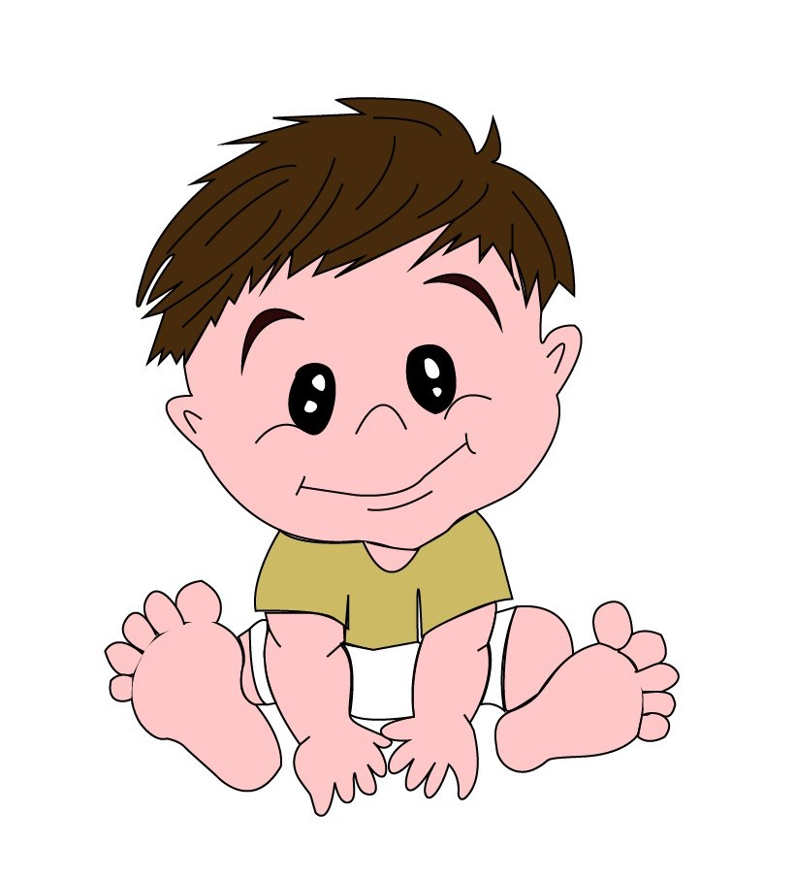
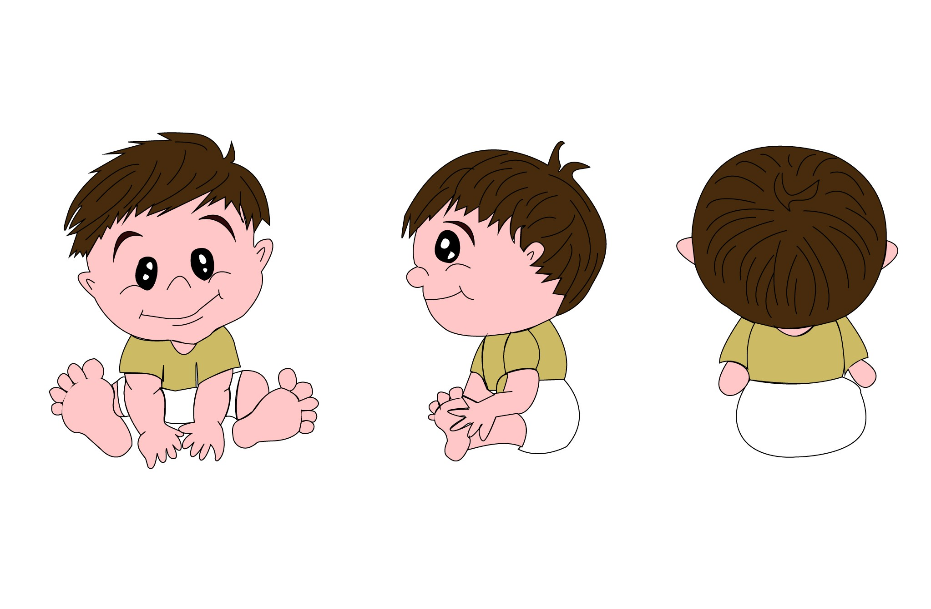
Character Design
Little brother’s character turn around
The little brother
He is a 2 years old baby and very emotional, curious.

Slide 5
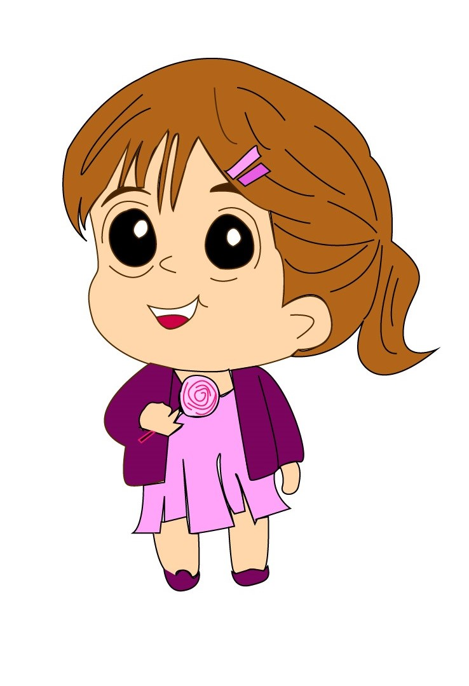
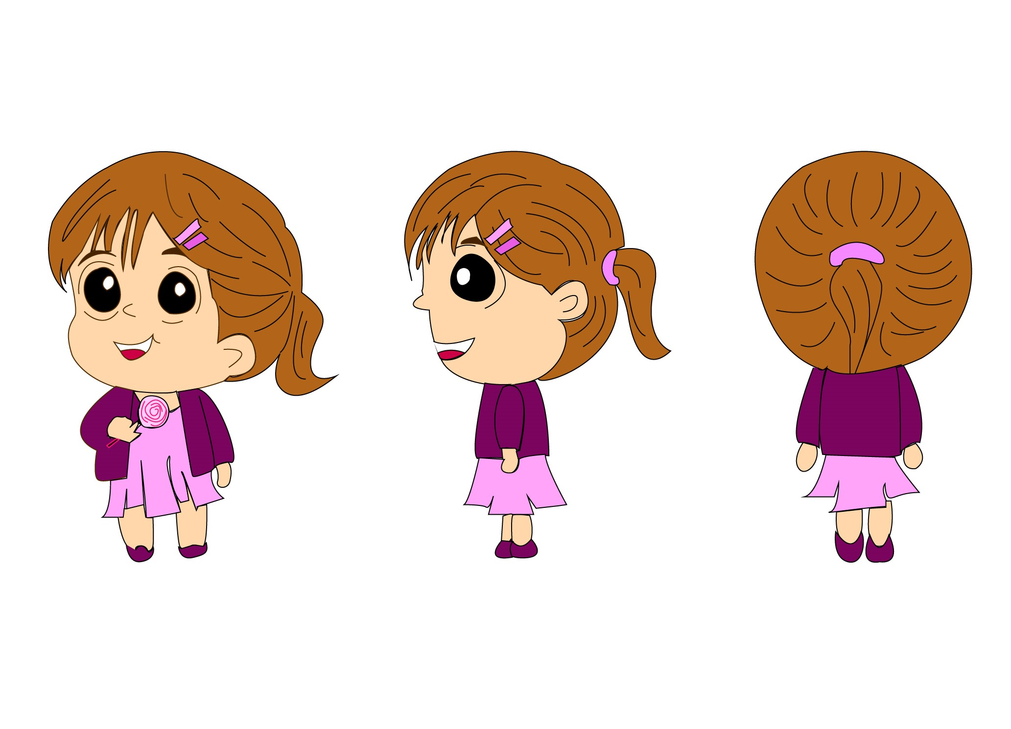
Character Design
Sister’s character turn around
The sister
She is a 6 years old .She is emotional, curious and love to imagine.

Slide 6
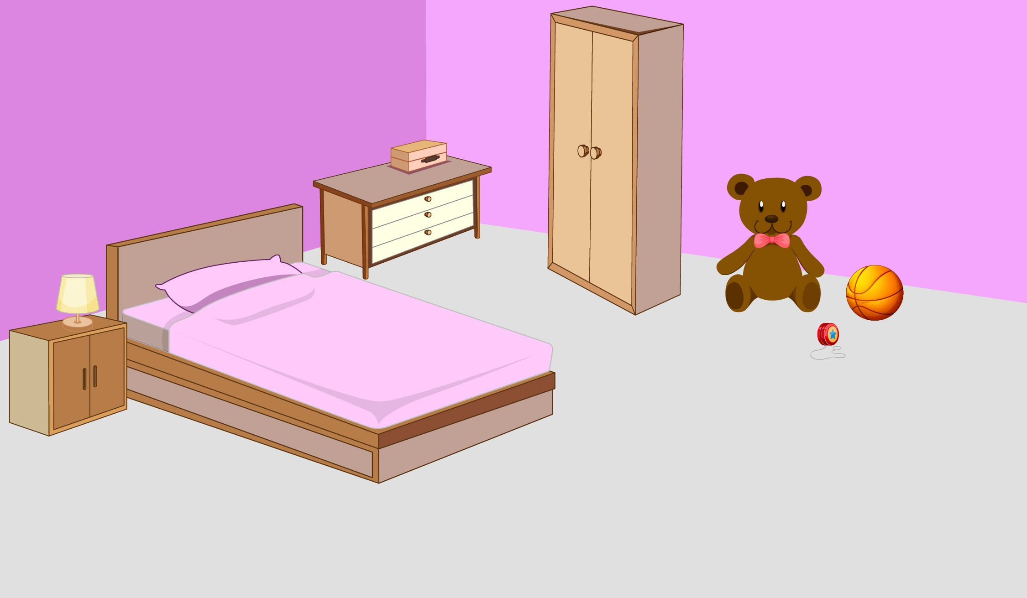
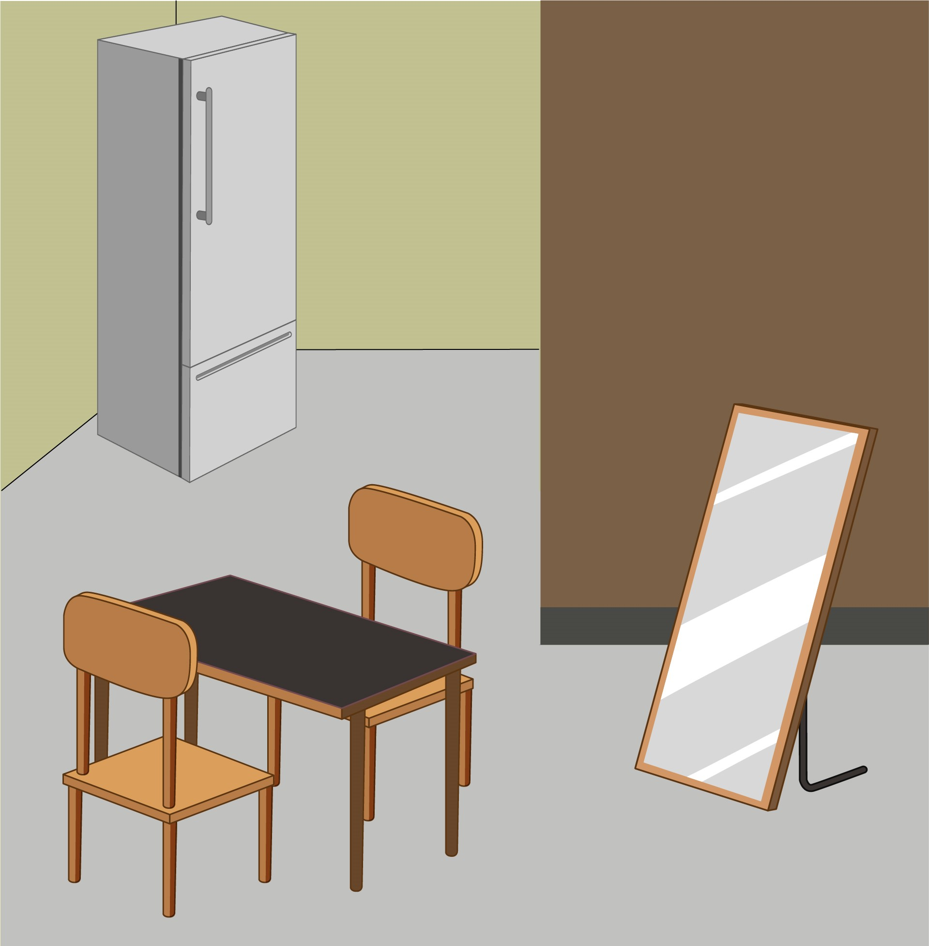
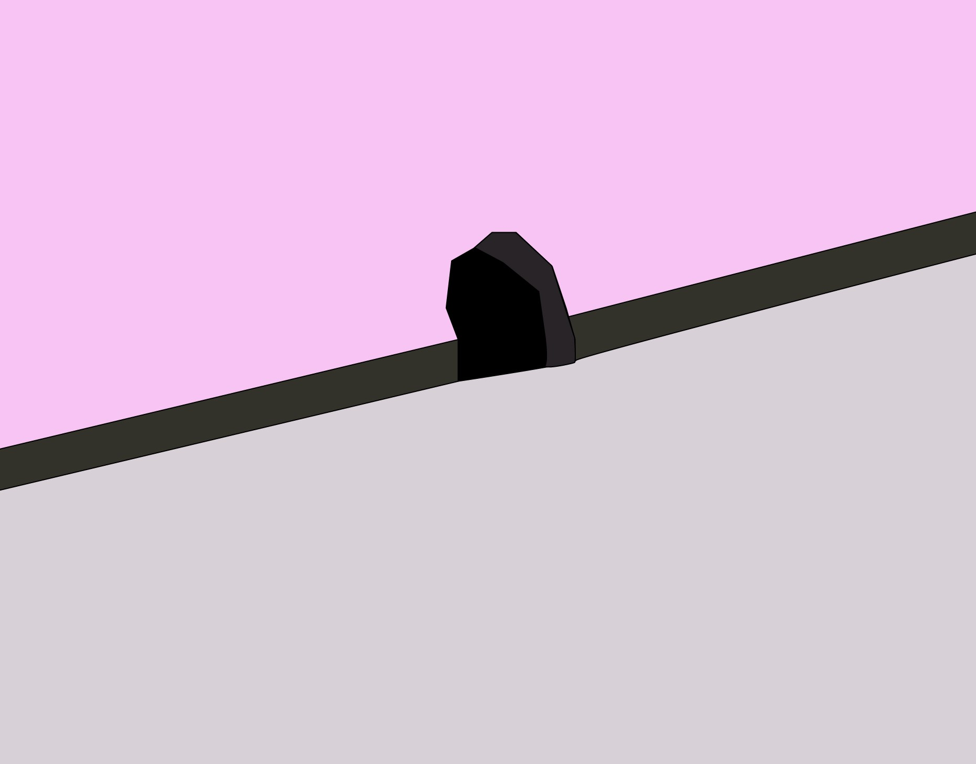
Backgrounds
Sister Bedroom
Mice Hole
Mirror Background

Slide 7
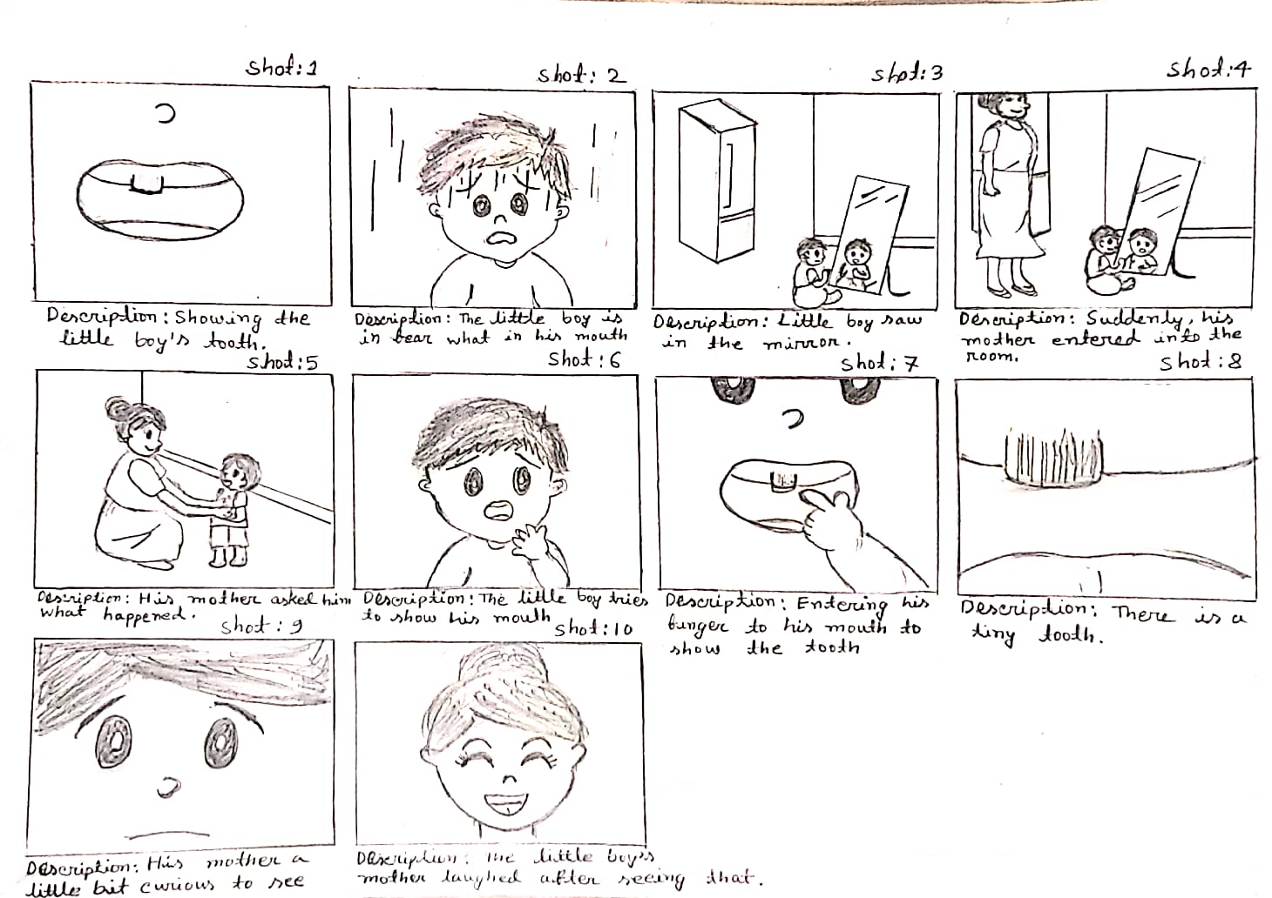
Storyboard

Slide 8


